Slide 1
Lossless data compression for genome sequences using recurrent neural networks
Arnoud De Jonge, Ewout Vlaeminck
Notes:
Ewout

Slide 2

Data
Human Genome Resources NCBI
Reference Genome Sequence GRCh38
(FASTA)
Notes:
Ewout

Slide 3
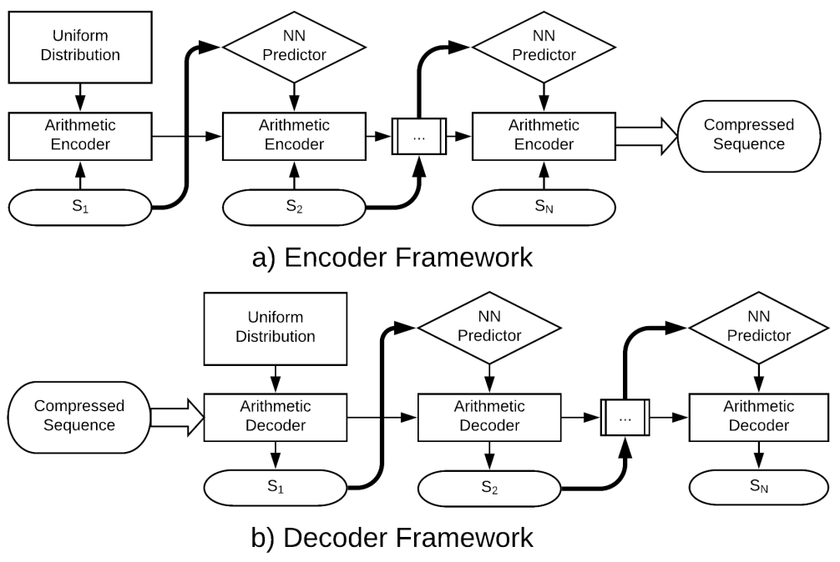
DeepZip
Encoder:
Decoder:
Notes:
Ewout

Slide 4
Parsing
A → 1
C → 2
G → 3
T → 4
Other symbols: converted to unknown = N → 0
Note: we don’t make a difference between lowercase ‘a’ and uppercase ‘A’
Notes:
Ewout

Slide 5
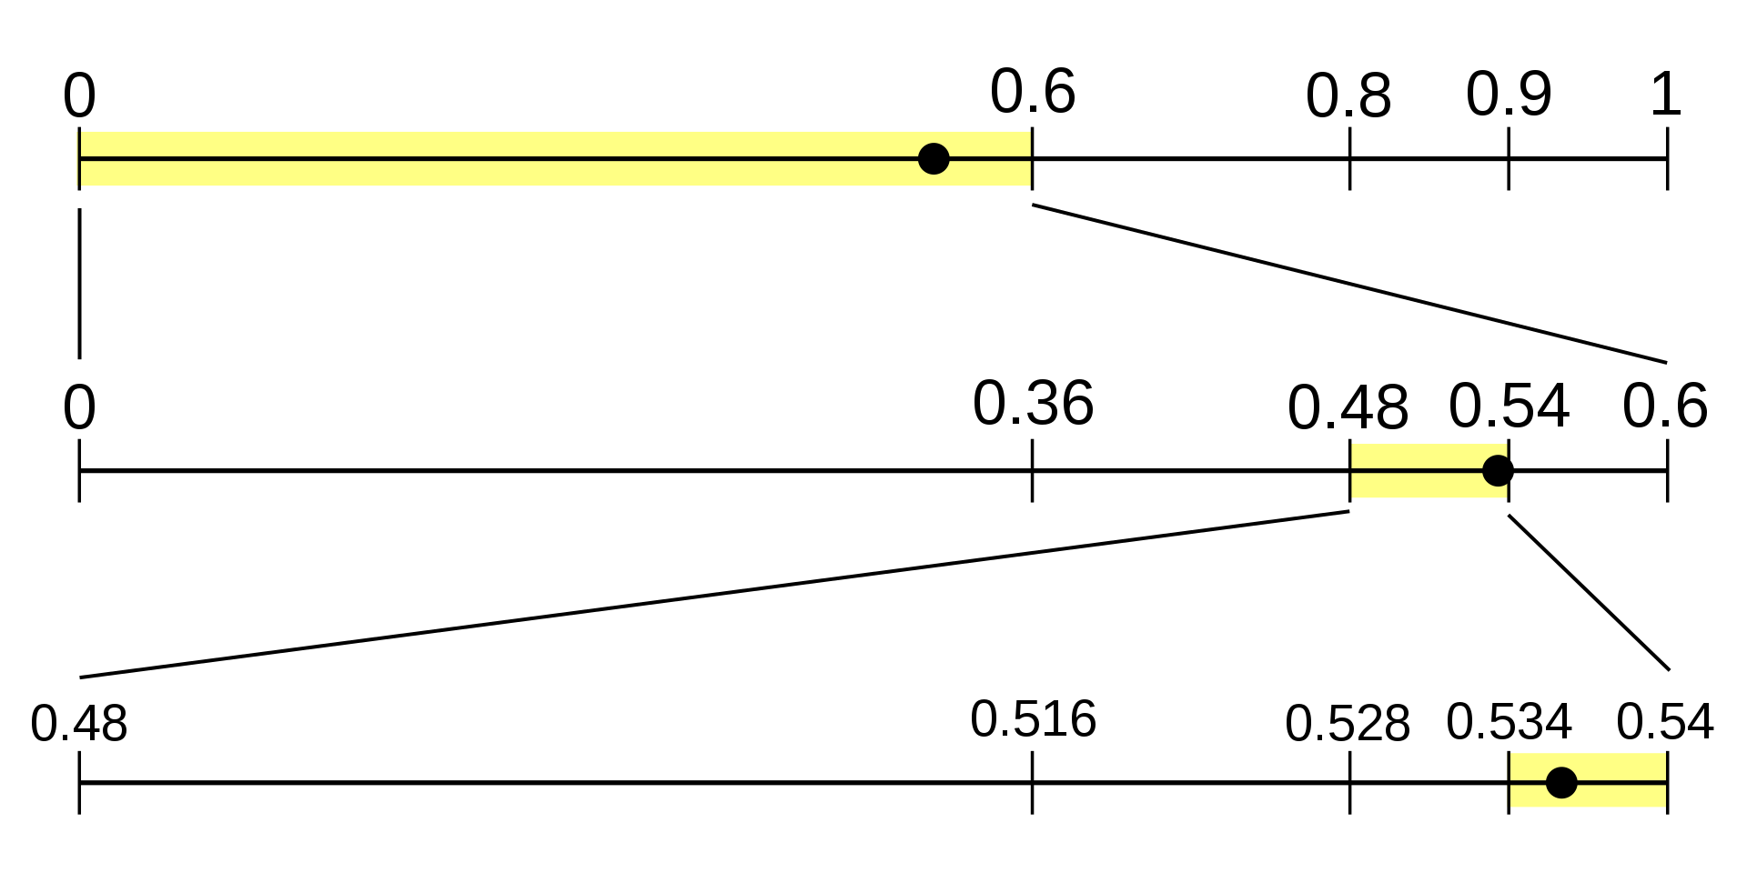
Arithmetic coding
Notes:
Ewout

Slide 6
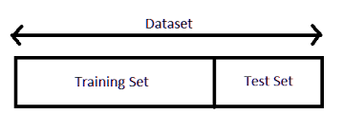

Our Goal:
Traditional model <> Single File Model
1 Model <> 1 Model for each file
= Training
Notes:
Ewout

Slide 7
Models Architecture
Input
Embedding layer
Middle Layer(s)
Dense layer (relu + softmax)
Embedding
LSTM/GRU/…
Dense
Output
Notes:
Arnoud

Slide 8
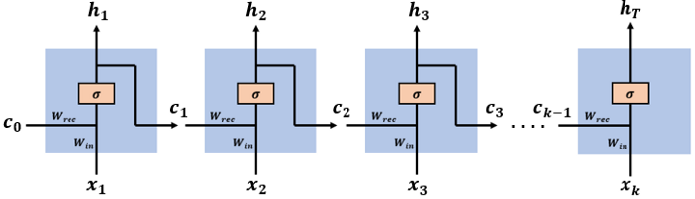
Simple RNN
Fully-connected RNN where the output is to be fed back to input.
Suffers from vanishing gradients
Notes:
Arnoud

Slide 9
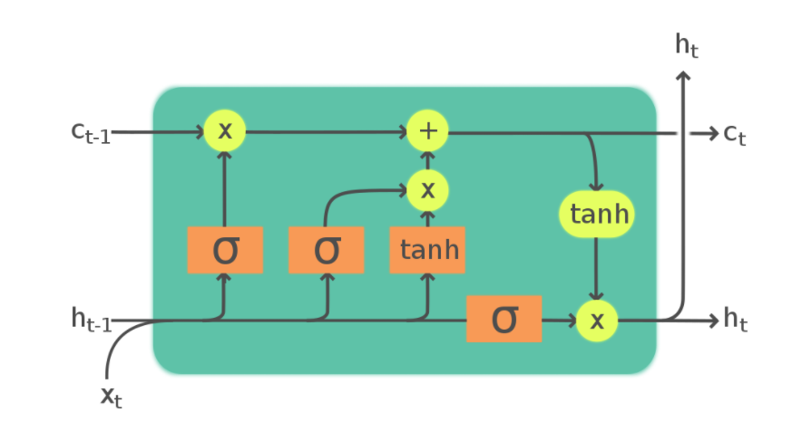
Long short-term memory (LSTM)
Solution to vanishing gradients problem
Forget gate: reset own state
Notes:
Arnoud

Slide 10
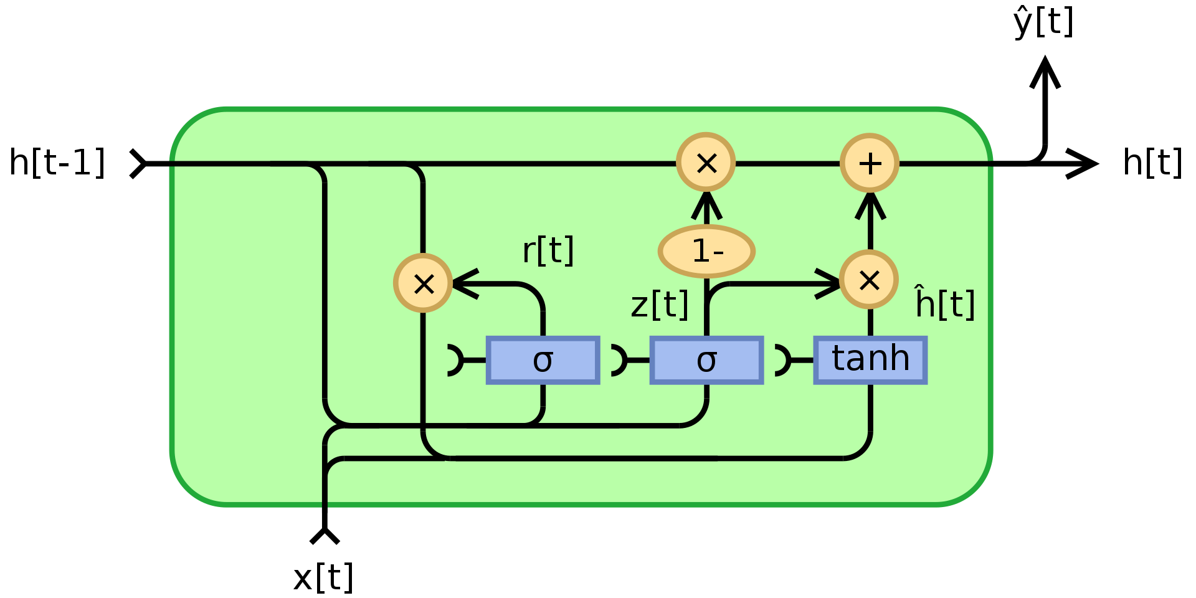
Gated recurrent unit (GRU)
Reset gate
Update gate
Notes:
Arnoud

Slide 11
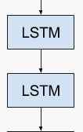
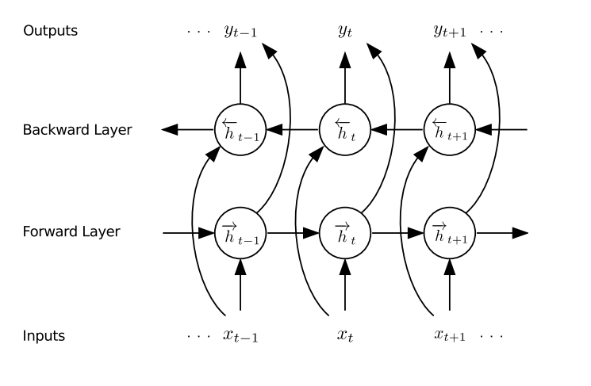
Double Layer + Bidirectional
Double the layer → Stacked model
Bidirectional
Notes:
Arnoud

Slide 12
Results
Different architectures with different input/model sizes
Compression factor
Training time
Compression/Decompression time
Notes:
Ewout

Slide 13
Results
Compression method | Size | Model
Equal probabilities | 297 kB | N/A
Fair probabilities | 256 kB | N/A
Windows ZIP | 299 kB | N/A
Compression:
1023 kB file
Simple RNN single (size 32) | 245 kB | 467 kB
Simple RNN single (size 64) | 247 kB | 636 kB
Simple RNN single (size 128) | 247 kB | 1.09 MB
biSimple RNN double (size 32) | 247 kB | 2.11 MB
biSimple RNN double (size 64) | 247 kB | 2.87 MB
LSTM single (size 32) | 239 kB | 1.20 MB
LSTM single (size 64) | 234 kB | 1.71 MB
LSTM single (size 128) | 232 kB | 3.32 MB
biLSTM double (size 32) | 234 kB | 6.11 MB
biLSTM double (size 64) | 231 kB | 8.85 MB
biLSTM double (size 128) | 229 kB | 18.8 MB
GRU single (size 32) | 238 kB | 1.01 MB
GRU single (size 64) | 235 kB | 1.42 MB
GRU single (size 128) | 240 kB | 2.65 MB
biGRU double (size 32) | 235 kB | 5.13 MB
biGRU double (size 64) | 245 kB | 7.21 MB
biGRU double (size 128) | 244 kB | 14.7 MB
Notes:
Ewout

Slide 14
Results
Training time:
10 epochs
Model (size 32 - 128) | Training time
Simple RNN single | 1.5 - 4 hours
LSTM single | 1 - 2 hours
GRU single | 0.85 - 1.5 hours
biSimple RNN double | 10 - 50 hours
biLSTM double | 2.25 - 5.5 hours
biGRU double | 2 - 4.75 hours
Notes:
Arnoud

Slide 15
Results
Compression /
Decompression
time
Model | Compression time | Decompression time
LSTM single (size 32) | 1.25 minutes | 12 hours
GRU single (size 32) | 1 minute | 12 hours
Simple RNN single (size 32) | 3 minutes | 12 hours
LSTM single (size 64) | 2.5 minutes | 13 hours
GRU single (size 64) | 2.25 minutes | 13 hours
Simple RNN single (size 64) | 4.5 minutes | 14 hours
LSTM single (size 128) | 10 minutes | 18 hours
GRU single (size 128) | 7.5 minutes | 20 hours
Simple RNN single (size 128) | 8.5 minutes | 20 hours
Notes:
Arnoud

Slide 16
Problems
Long training time
Huge bottleneck in decompression
Notes:
Arnoud

Slide 17
Reducing training time
Reducing training time
→ Less epochs
Model (size) (epochs) | time | size
LSTM single (32) (10) | 60 minutes | 239 kB
LSTM single (32) (2) | 12 minutes | 244 kB
LSTM single (32) (1) | 6 minutes | 245 kB
LSTM single (64) (10) | 90 minutes | 234 kB
LSTM single (64) (2) | 18 minutes | 241 kB
LSTM single (64) (1) | 9 minutes | 243 kB
GRU single (32) (10) | 50 minutes | 238 kB
GRU single (32) (2) | 10 minutes | 243 kB
GRU single (32) (1) | 5 minutes | 244 kB
GRU single (64) (10) | 70 minutes | 235 kB
GRU single (64) (2) | 14 minutes | 241 kB
GRU single (64) (1) | 7 minutes | 243 kB
Notes:
Arnoud

Slide 18
Comparing with traditional model
Trained on 5 other random files:
10 epochs
Trained on single file: <>
1 epoch
Note: the compression/decompression time is still the same
Model (size) | Compression
LSTM single (32) | 245 kB
LSTM single (64) | 243 kB
GRU single (32) | 244 kB
GRU single (64) | 243 kB
Model (size) | Compression
LSTM single (32) | 248 kB
LSTM single (64) | 246 kB
GRU single (32) | 246 kB
GRU single (64) | 247 kB
Notes:
Arnoud

Slide 19
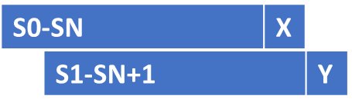
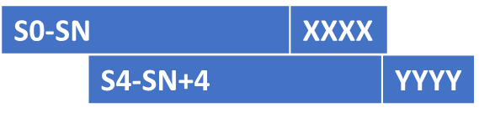
Reducing Decompression time (Future work)
Less ‘one by one’ predictions
predict M characters as output
Split sequence in smaller part to allowed parallel predictions (multiple starting points)
Notes:
Ewout

Slide 20
Conclusion
Creating one model to compress exactly one file
→ Not beneficial compared to a traditional model
Increase: compression and decompression time
No proper gain in compression factor
Notes:
Ewout

Slide 21
Ewout.Vlaeminck@UGent.be
Arnoud.DeJonge@UGent.be

